Slide 1
PowerPoint Slides prepared by:
Andreea CHIRITESCU
Eastern Illinois University
© 2012 Cengage Learning. All Rights Reserved. May not be copied, scanned, or duplicated, in whole or in part, except for use as permitted in a license distributed with a certain product or service or otherwise on a password-protected website for classroom use.

Slide 2
Ten Principles of Economics
© 2012 Cengage Learning. All Rights Reserved. May not be copied, scanned, or duplicated, in whole or in part, except for use as permitted in a license distributed with a certain product or service or otherwise on a password-protected website for classroom use.

Slide 3
Ten Principles of Economics
Economy – “oikonomos” (Greek)
  “One who manages a household”
Household - many decisions
  Allocate scarce resources
    Ability, effort, and desire
Society - many decisions
  Allocate resources
  Allocate output
© 2012 Cengage Learning. All Rights Reserved. May not be copied, scanned, or duplicated, in whole or in part, except for use as permitted in a license distributed with a certain product or service or otherwise on a password-protected website for classroom use.

Slide 4
Ten Principles of Economics
Resources are scarce
Scarcity
  The limited nature of society’s resources
Economics
  Study of how society manages its scarce resources
© 2012 Cengage Learning. All Rights Reserved. May not be copied, scanned, or duplicated, in whole or in part, except for use as permitted in a license distributed with a certain product or service or otherwise on a password-protected website for classroom use.

Slide 5
Ten Principles of Economics
Economists study:
  How people make decisions
  How people interact with one another
  Analyze forces and trends that affect the economy as a whole
© 2012 Cengage Learning. All Rights Reserved. May not be copied, scanned, or duplicated, in whole or in part, except for use as permitted in a license distributed with a certain product or service or otherwise on a password-protected website for classroom use.

Slide 6
How People Make Decisions
Principle 1: People face trade-offs
Making decisions
  Trade off one goal against another
  Student – time
  Parents – income
  Society
    National defense vs. consumer goods
    Clean environment vs. high level of income
    Efficiency vs. equality
© 2012 Cengage Learning. All Rights Reserved. May not be copied, scanned, or duplicated, in whole or in part, except for use as permitted in a license distributed with a certain product or service or otherwise on a password-protected website for classroom use.

Slide 7
How People Make Decisions
Efficiency
  Society getting the most it can from its scarce resources
  Size of the economic pie
Equality
  Distributing economic prosperity uniformly among the members of society
  How the pie is divided into individual slices
© 2012 Cengage Learning. All Rights Reserved. May not be copied, scanned, or duplicated, in whole or in part, except for use as permitted in a license distributed with a certain product or service or otherwise on a password-protected website for classroom use.

Slide 8
How People Make Decisions
Principle 2: The cost of something is what you give up to get it
People face trade-offs
  Make decisions
    Compare cost with benefits of alternatives
Opportunity cost
  Whatever must be given up to obtain one item
© 2012 Cengage Learning. All Rights Reserved. May not be copied, scanned, or duplicated, in whole or in part, except for use as permitted in a license distributed with a certain product or service or otherwise on a password-protected website for classroom use.

Slide 9
How People Make Decisions
Principle 3: Rational people think at the margin
Rational people
  Systematically & purposefully do the best they can to achieve their objectives
Marginal changes
  Small incremental adjustments to a plan of action
© 2012 Cengage Learning. All Rights Reserved. May not be copied, scanned, or duplicated, in whole or in part, except for use as permitted in a license distributed with a certain product or service or otherwise on a password-protected website for classroom use.

Slide 10
How People Make Decisions
Marginal benefits
  Additional benefits
Marginal costs
  Additional costs
Rational decision maker
  Take action only if:
  Marginal benefits > Marginal costs
© 2012 Cengage Learning. All Rights Reserved. May not be copied, scanned, or duplicated, in whole or in part, except for use as permitted in a license distributed with a certain product or service or otherwise on a password-protected website for classroom use.

Slide 11
How People Make Decisions
Principle 4: People respond to incentives
Incentive
  Something that induces a person to act
  Higher price
    Buyers - consume less
    Sellers - produce more
  Public policy
    Change costs or benefits
    Change people’s behavior
© 2012 Cengage Learning. All Rights Reserved. May not be copied, scanned, or duplicated, in whole or in part, except for use as permitted in a license distributed with a certain product or service or otherwise on a password-protected website for classroom use.

Slide 12
The Incentive Effects of Gasoline Prices
2005 to 2008, price of oil in world oil markets skyrocketed
  Limited supplies
  Surging demand from robust world growth
  Price of gasoline in the United States rose from about $2 to about $4 a gallon
© 2012 Cengage Learning. All Rights Reserved. May not be copied, scanned, or duplicated, in whole or in part, except for use as permitted in a license distributed with a certain product or service or otherwise on a password-protected website for classroom use.

Slide 13
The Incentive Effects of Gasoline Prices
Increased incentive to conserve gas
  Smaller cars, scooters, bicycles, mass transit
  Camels (India)
  New, more fuel-efficient aircraft
    Airbus A320 and Boeing 737
  Moving near an Amtrak station
  Online courses
  Sean “Diddy” Combs - flying on commercial airlines
© 2012 Cengage Learning. All Rights Reserved. May not be copied, scanned, or duplicated, in whole or in part, except for use as permitted in a license distributed with a certain product or service or otherwise on a password-protected website for classroom use.

Slide 14
How People Interact
Principle 5: Trade can make everyone better off
Trade
  Allows each person to specialize in the activities he or she does best
  Enjoy a greater variety of goods and services at lower cost
© 2012 Cengage Learning. All Rights Reserved. May not be copied, scanned, or duplicated, in whole or in part, except for use as permitted in a license distributed with a certain product or service or otherwise on a password-protected website for classroom use.

Slide 15
How People Interact
Principle 6: Markets are usually a good way to organize economic activity
Communist countries – central planning
  Government officials (central planners)
    Allocate economy’s scarce resources
      What goods & services were produced
      How much was produced
      Who produced & consumed these goods & services
© 2012 Cengage Learning. All Rights Reserved. May not be copied, scanned, or duplicated, in whole or in part, except for use as permitted in a license distributed with a certain product or service or otherwise on a password-protected website for classroom use.

Slide 16
How People Interact
Market economy - allocates resources
  Through decentralized decisions of many firms and households
  As they interact in markets for goods and services
  Guided by prices and self interest
© 2012 Cengage Learning. All Rights Reserved. May not be copied, scanned, or duplicated, in whole or in part, except for use as permitted in a license distributed with a certain product or service or otherwise on a password-protected website for classroom use.

Slide 17
How People Interact
Adam Smith’s “invisible hand”
  Households and firms interacting in markets
    Act as if they are guided by an “invisible hand”
    Leads them to desirable market outcomes
  Corollary: Government intervention
    Prevents the invisible hand’s ability to coordinate the decisions of the households and firms that make up the economy
© 2012 Cengage Learning. All Rights Reserved. May not be copied, scanned, or duplicated, in whole or in part, except for use as permitted in a license distributed with a certain product or service or otherwise on a password-protected website for classroom use.

Slide 18
How People Interact
Principle 7: Governments can sometimes improve market outcomes
We need government
  Enforce rules and maintain institutions
    Enforce property rights
  Promote efficiency
    Avoid market failure
  Promote equality
    Avoid disparities in economic wellbeing
© 2012 Cengage Learning. All Rights Reserved. May not be copied, scanned, or duplicated, in whole or in part, except for use as permitted in a license distributed with a certain product or service or otherwise on a password-protected website for classroom use.

Slide 19
How People Interact
Property rights
  Ability of an individual to own and exercise control over scarce resources
Market failure
  Situation in which the market on its own fails to produce an efficient allocation of resources
© 2012 Cengage Learning. All Rights Reserved. May not be copied, scanned, or duplicated, in whole or in part, except for use as permitted in a license distributed with a certain product or service or otherwise on a password-protected website for classroom use.

Slide 20
How People Interact
Causes for market failure
Externality
  Impact of one person’s actions on the well-being of a bystander
Market power
  Ability of a single economic actor (or small group of actors) to have a substantial influence on market prices
© 2012 Cengage Learning. All Rights Reserved. May not be copied, scanned, or duplicated, in whole or in part, except for use as permitted in a license distributed with a certain product or service or otherwise on a password-protected website for classroom use.

Slide 21
How People Interact
Disparities in economic wellbeing
  Market economy rewards people
    According to their ability to produce things that other people are willing to pay for
  Government intervention: Public policies
    May diminish inequality
    Process far from perfect
© 2012 Cengage Learning. All Rights Reserved. May not be copied, scanned, or duplicated, in whole or in part, except for use as permitted in a license distributed with a certain product or service or otherwise on a password-protected website for classroom use.

Slide 22
How the Economy as a Whole Works
Principle 8: A country’s standard of living depends on its ability to produce goods and services
Large differences in living standards
  Among countries
  Over time
Explanation: differences in productivity
© 2012 Cengage Learning. All Rights Reserved. May not be copied, scanned, or duplicated, in whole or in part, except for use as permitted in a license distributed with a certain product or service or otherwise on a password-protected website for classroom use.

Slide 23
How the Economy as a Whole Works
Productivity
  Quantity of goods and services produced from each unit of labor input
  Higher productivity
    Higher standard of living
  Growth rate of nation’s productivity
    Determines growth rate of its average income
© 2012 Cengage Learning. All Rights Reserved. May not be copied, scanned, or duplicated, in whole or in part, except for use as permitted in a license distributed with a certain product or service or otherwise on a password-protected website for classroom use.

Slide 24
How the Economy as a Whole Works
Principle 9: Prices rise when the government prints too much money
Inflation
  An increase in the overall level of prices in the economy
Causes for large / persistent inflation
  Growth in quantity of money
    Value of money falls
© 2012 Cengage Learning. All Rights Reserved. May not be copied, scanned, or duplicated, in whole or in part, except for use as permitted in a license distributed with a certain product or service or otherwise on a password-protected website for classroom use.

Slide 25
How the Economy as a Whole Works
Principle 10: Society faces a short-run trade-off between inflation and unemployment
Short-run effects of monetary injections:
  Stimulates the overall level of spending
    Higher demand for goods and services
  Firms – raise prices; hire more workers; produce more goods and services
  Lower unemployment
© 2012 Cengage Learning. All Rights Reserved. May not be copied, scanned, or duplicated, in whole or in part, except for use as permitted in a license distributed with a certain product or service or otherwise on a password-protected website for classroom use.

Slide 26
How the Economy as a Whole Works
Short-run trade-off between unemployment and inflation
  Key role – analysis of business cycle
Business cycle
  Fluctuations in economic activity
    Employment
    Production
© 2012 Cengage Learning. All Rights Reserved. May not be copied, scanned, or duplicated, in whole or in part, except for use as permitted in a license distributed with a certain product or service or otherwise on a password-protected website for classroom use.

Slide 27
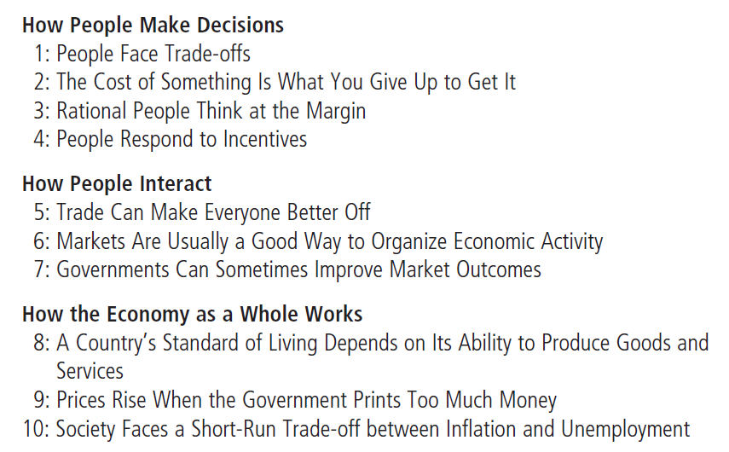
Table 1
Ten Principles of Economics
© 2012 Cengage Learning. All Rights Reserved. May not be copied, scanned, or duplicated, in whole or in part, except for use as permitted in a license distributed with a certain product or service or otherwise on a password-protected website for classroom use.

